Slide 1

SPEECHES
Definition(s)
The expression of or the ability to express thoughts and feelings by articulate sounds.
OUR FOCUS
A formal address or discourse delivered to an audience.
Speech is communication through talking or a talk given to an audience.
An example of speech is a conversation between two people. An example of speech is the presidential address. The study of oral communication, speech sounds, and vocal physiology.

Slide 2
INTRODUCTION TO SPEECH WRITING
Traditionally speaking, the act of communicating via speech has been viewed as a two-way process between speaker and listener(s) that involves the ‘productive’ skill of speaking and the ‘receptive’ skill of listening.
However, it is recognized now that the speaker and the listener both participate actively in the process i.e. the speaker encodes the message to be conveyed using appropriate language, and the listener decodes (or interprets) the message.
In normal speech situations, the message contains a large amount of information comprising both spoken (i.e. linguistic) and ‘unspoken’ (extra-linguistic and non-linguistic) signals.

Slide 3
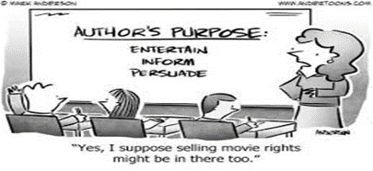

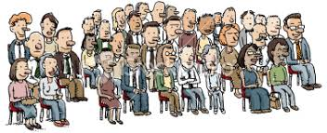
BEFORE DRAFTING
AUDIENCE
ORATOR
PURPOSE

Slide 4
PURPOSE
Pass information, report on something, explain a new policy, persuade an audience, commemorate an anniversary, celebrate an achievement, drive and action
ORATOR- WHO IS DELIVERING THE SPEECH?
Find out their favourable vocabulary, personal convictions, public stance, how long they want to deliver the speech, how they want the document to be presented (font, size, page number, etc)
AUDIENCE
Who will be listening, what are their convictions, why are they attending, how much do they already know about the topic, what else would they accept, etc.

Slide 5
LINGUISTIC CONSIDERATIONS
PHONETICS
SYNTAXES
SEMANTICS
PRAGMATIC
MORPHOLOGY

Slide 6
Phonology
how speech sounds are organised in the mind and used to convey meaning (ex. Weight, Wait)
Morphology
units of words that have a meaning and cannot be subdivided further (ex prefixs- anti- against/antigene, fore before/forcast)
(suffixes- ible, ful/painful or spoonful, ible-able/flexible)
Syntactic
order or arrangement of words and phrases to form proper sentences
(ex subject + verb + object=Peter bought a car)
Semantic
figurative and literal use of language to produce meaning. The message or meaning behind a term, phrase, or sentence
(ex. The word "run" has many meanings-physically running, depart or go (I have to run, spent (it has run its course), or even a snag in a pair of hose (a run in my hose).
Pragmatic- Practical rather than theoretical.

Slide 7
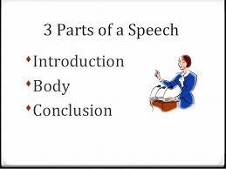
PARTS OF A SPEECH

Slide 8
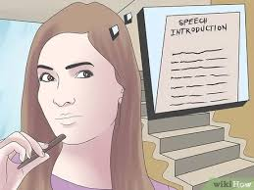
INTRODUCTION
The introduction usually states the purpose of the speech. A good introduction serves as an attention getter, previews
the topic and main ideas, and establishes your credibility as a speaker.
Some good ways to grab attention include using a quotation, telling a story, posing questions, using humor, using startling
facts or statistics, providing an illustration or anecdote, or referencing historical or recent events. A preview statement identifies the main points of the speech, helping the audience focus on the key points of the remainder of the presentation.
EX.
Distinguished Members of Government here present;
Esteemed ;
Excellencies, Members of ………
Distinguished Religious and Traditional authorities
Dear………………..
Ladies and Gentlemen;
Cameroon is indeed highly delighted to ……once more commune with………….. in commemorating another………
This year,……will be on the spotlight in two key dimensions. Firstly, it……Secondly, …his is the reason why………

Slide 9

BODY
The body is the largest part of the speech, where you provide the audience with the major supporting materials. The main points of the speech are contained in this section.
Main points should flow from the speech’s goal and thesis statement. It is advisable to limit your content to include between two and five main points, with a maximum of seven main points.
Speeches with three main points are common. If you have too many main points, your audience will forget them.
Focusing on a few points and providing effective supporting points for each makes your speech more memorable.
Supporting points are the supporting materials you have collected to justify your main points. These help to substantiate your thesis.

Slide 10
EXAMPLE OF THE BODY OF A SPEECH
Excellencies, Esteemed Guests, Ladies and Gentlemen,
Even more than last year, the choice of the Reunification Monument in Yaounde is compelling in many regards.
To every Cameroonian, Yaounde is the natural venue for the celebration of connection, innovation and transformation. The city is an authentic cosmopolitan harbour of networks, an incubator of youth talents and a laboratory for urban transformation. It is therefore no surprise that Yaounde symbolises Cameroonian oneness and indivisibility and heartily accommodates the various constituent identities of our dear country……………
Ladies and Gentlemen,
As you must have noticed, it is not by coincidence that this edifice seats at the heart of Cameroon’s military headquarters. It is shielded by the brave and professional young men and women who shoulder high the flag of Cameroon, even at the cost of their lives. Young people who have the firm conviction that peace and security are prerequisites to the social, economic and political development of our country……..
Distinguished guests, ladies and gentlemen,
Permit me walk through the line-up of activities which is a demonstration of the different ways the people of Cameroon ………………………..

Slide 11
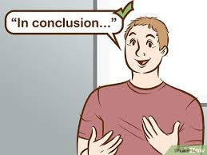
CONCLUSION
The conclusion wraps up the presentation by providing a summary of what the audience was supposed to have learned or have been persuaded to do during the presentation.
You can signal that the conclusion is approaching by using key phrases, such as “finally,” “let me close by saying,” “I’d like to stress these three points,” and “in conclusion.”
Because the conclusion is the last opportunity to motivate your listeners, it should end strongly.
For a persuasive speech, a strong ending would be a call to action, where you tell the audience members they should do something with the information they have learned.

Slide 12
TYPES OF SPEECHES
Speeches can be divided into the following categories:
INFORMATIVE SPEECH
If the speech’s purpose is to define, explain, describe, or demonstrate, it is an informative speech. The goal of an informative speech is to provide information completely and clearly so that the audience understands the message.
Examples of informative speeches include
describing the life cycle stages of a career,
explaining how to operate an equipment,
demonstrating how to walk through a procedure.

Slide 13
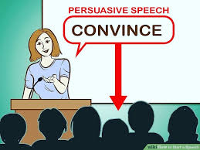
Persuasive Speech
Persuasive speeches are given to reinforce people’s beliefs about a topic, to change their beliefs about a topic, or to move them to act.
When speaking persuasively, directly state what is good or bad and why you think so near the beginning of the speech. This is your thesis statement that you want to make early on.
Since your purpose is to persuade using logic and reasoning, this communicates to listeners that you want to convince them of your point of view.

Slide 14
Speeches for special occasions.
Speeches for special occasions are prepared for a specific occasion and for a specific purpose dictated by that occasion.
Speeches for special occasions can be informative, persuasive, or both, depending on the occasion.
Two of the more common types of speeches for special occasions are the speech of introduction and the speech of welcome.
The speech of introduction is a brief speech that provides the main speaker’s qualifications. This speech prepares the audience for the main speaker by establishing the speaker’s credibility and helps make the speaker feel welcome.
The speech of welcome acknowledges and greets a person or group of people.

Slide 15
THANK YOU FOR YOUR KIND ATTENTION
QUESTIONS AND ANSWERS
SIMULATION EXERCISES

