Slide 1
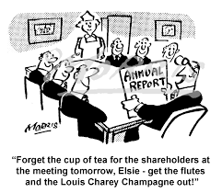
ADMINISTRATIVE DRAFTING IN ENGLISH
HOW TO PREPARE COMPREHENSIVE REPORTS
Tarh Besong Frambo
Sub-Director for Political and Legal Cooperation
Commonwealth Department
Ministry of External Relations

Slide 2
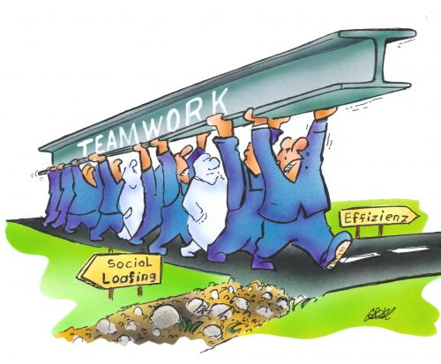
PLAN
1-Introduction, Basic Definitions and importance
2-Types of Reports
3-Structure
4-Method
5-Case Studies/workshop

Slide 3
INTRODUCTION
Basics
A report is a structured written presentation developed as a response to a specific purpose, aim or request.
The purpose of a report is to give an account of something, to offer a solution to a problem, or to answer a question.
Reporting is primarily a tool to enhance accountability, assist in organisational learning and decision-making and improve communication both internally and externally.

Slide 4
Basics- continued
A good reporting process is a cyclical one that ensures feedback and consequently decision making can take place between organisations and contractors.
Reports alone will provide little value if they fail to inform stakeholders or support a dialogue that influences the decisions and behaviour of both the reporting organisation and its stakeholders.
Report Development is primarily the responsibility of the report writer, who should discuss with the destinee the type of report that should be written and what form it should take.

Slide 5
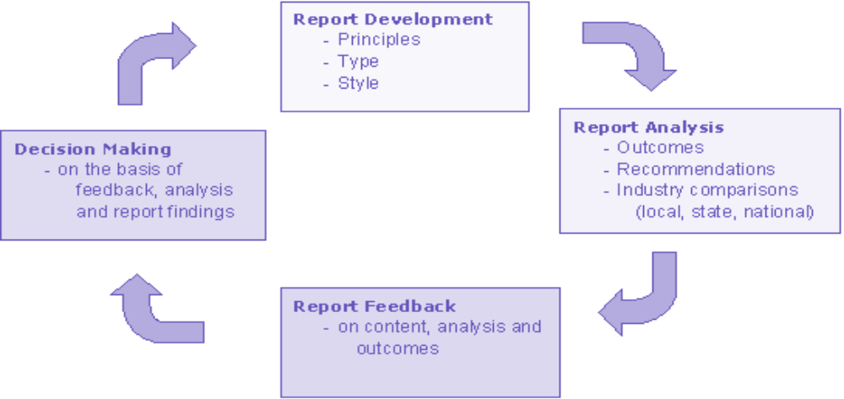
REPORT CYCLE

Slide 6
FEATURES OF A GOOD REPORT
An effective report has the following characteristics:
Appropriate to the purpose – this is clearly identified from the outset, so that the
conclusions and or/recommendations will be relevant;
Appropriate to the audience – the reader’s knowledge will influence the type of background detail that will need to be in the report and the emphasis that will be placed on particular issues of interest
Accurate and complete – this is essential for a high quality report;
Logical – this enables the report to be easily understood;
Clear, concise and well organized with clear section headings – this will assist in leading the reader logically to the conclusions and recommendations.

Slide 7
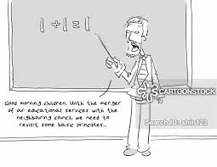
PRINCIPLES OF REPORTING
Reporting principles are an integral part of a good reporting framework to ensure that both the writer and report user share a common understanding of the underpinnings of the report.
The principles should be applied to all report preparation, particularly to the development of performance assessment reports.
Principles contribute to a foundation upon which future reports will continue to evolve based on new knowledge and learning.
Reporting principles are goals to which a reporter should strive and some organisations will not be able to fully apply them immediately.

Slide 8
TRANSPARENCY as an overarching principle is the centrepiece of accountability. It requires full disclosure of the processes, procedures and assumptions in report preparation.
INCLUSIVENESS is based on the premise that stakeholder views are integral to meaningful reporting and therefore organisations should systematically engage stakeholders to help
TRANSPARANCY
INCLUSIVENESS
COMPLETENESS, ACCURATE, RELEVANT, NEUTRAL, TIMELY, CONTEXTUAL, AUDITABLE

Slide 9
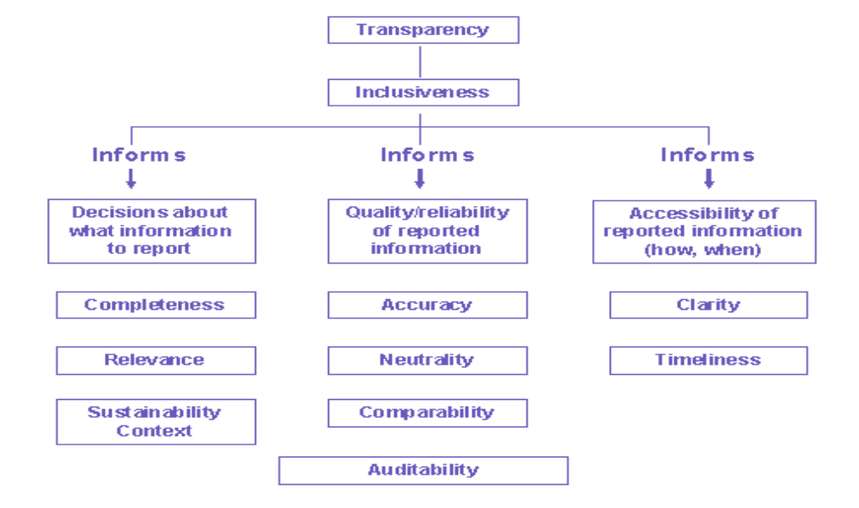

Slide 10
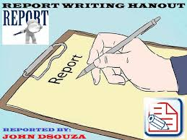
TYPES OF REPORTS
TRAINING REPORT
Generally, a training report will evaluate the positive and negative aspects of a training program after the event has occurred. As such, you'll start by defining the training program with a cover page that includes the name, location and date of the training.
CONTRACT REPORT
Contract reports are often seen as the most difficult and onerous reports to write. They are primarily required for accountability and performance assessment purposes.
PROJECT REPORT
The final project report is an important element in closing a project. Project reports are usually written by the project manager and provide detail on the overall project at the point of
completion.
EVALUATION REPORT S
Most organisations undertake evaluative exercises throughout the life of the project/program to check that the outcomes of the intervention are on target, to try and explain why certain things are happening and to learn and share important lessons. Planning the report should include determining what findings will be of interest to which stakeholder group and in which manner these are best communicated (Federal Office of Public Health, 1997). Evaluation reports are normally prepared at the midpoint of a project/program and at the end. Evaluation reports generally cover most if not all evaluation indicators, including the relevance, efficiency, effectiveness, impact and sustainability of the project/program

Slide 11
REPORTS-continued
ANNUAL REPORTS
The key purpose of an annual report, which is primarily a marketing tool, is to assist people in understanding and assessing the performance of an organisation. The audience of an annual report is varied and can include funding bodies, government organisations, clients and other interested stakeholders.
MEETING REPORT
Meeting Reports aim to summarize the most important aspects discussed during a meeting. It is not usually feasible to attempt a comprehensive coverage of the meeting, as issues are frequently too numerous for each to be reported. When/if that is done, it would become MINUTES.
FINANCIAL REPORT/STATEMENT
Written records that convey the business activities and the financial performance of a corporate body

Slide 12
STRUCTURE (DIFFERENT PARTS) OF A REPORT
Subject/Title
Executive Summary (short and self-contained)
Introduction (background – purpose of the report and why it is being written)
Main body of report (logical, orderly and easy-to-read)
Conclusions, observations and recommendations
For longer reports: table of contents, appendices (e.g. statistical or technical), references, bibliography, acknowledgments)

Slide 13
ADDITIONAL ELEMENTS OF STRUCTURE
Choose a clear, logical order, for example: chronological, by subject area, from general to specific, descending order of importance etc.
The signature, name and job title of the writer should be included, together with the date, at the bottom left-hand corner of the report, on separate lines.
A report should provide clear, factual information in a form which the reader can readily understand.
For most (but not all) reports, the writer will also need to draw some conclusions and/or make observations or recommendations, and it is only here that his/her personal opinion are relevant.
It is crucially important to separate the factual substance of the report (the main body) from any conclusions or recommendations.

Slide 14
LANGUAGE
REPORT
SIMPLE PAST
PAST PERFECT
PRESENT PERFECT
INDIRECT SPEECH

Slide 15
USE OF LANGUAGE
Reports on business activities are usually written in the simple past, present perfect and past perfect tenses.
Use of the simple past is appropriate when the report records events (e.g. a business trip) or actions that took place at a particular point in the past.
Examples
- Five members of staff went on further training later in the year.
-We ran into serious difficulties trying to…
-The branch manager gave me a brief account of the problems faced in Limbe

Slide 16
PRESENT PERFECT
present perfect
The present perfect is frequently used in reports because is the tense for actions taken which have relevance to the present:
Example
-We have had a very productive year.
-The company has moved to a new location.
-The cleaners have not been paid for months.

Slide 17
PAST PERFECT TENSES and INDIRECT SPEECH
The past perfect is used for actions that took place before the event reported upon:Ex-
Mr X wanted to know whether the committee had studied the audit report
When a report records a conversation, the use of indirect speech is appropriate:
The staff asked what the provisions of the new regulations were.
The Director said that he would henceforth transfer some of his prerogatives to his assistant.
Reports (e.g. on a business trip or an audit or investigation) can use the present tense if the account is of a situation that still prevails at the time of the report:

