Slide 1
ADMINISTRATIVE WRITING IN ENGLISH
Presenter
GABCHE JAMES NCHE
Director, Commonwealth Department
MINREX

Slide 2
ADMINISTRATIVE DRAFTING IN ENGLISH
TECHNICAL DOCUMENTS
MEMOS
MINUTES
CIRCULARS
SUMMARIES

Slide 3
MEMORANDUM (MEMO/NOTE)
Definition
a short note designating something to be remembered, especially something to be done or acted upon in the future; reminder. a record or written statement of something. an informal message, especially one sent between two or more employees of the same company, concerning company business.
A memorandum, shortly termed memo and also called ‘note’ is one of the most commonly used administrative documents.
It is used as an official note within the same service or structure from hierarchy to subordinates or subordinates to hierarchy.
Notes are commonly presented with the following elements: official header of the structure, date, addressee, subject, introduction, body and conclusion, signature, enclosures.

Slide 4
FEATURES
Notes/Memos are commonly presented with the following elements:
official header of the structure,
date,
addressee,
subject,
introduction,
body,
conclusion,
signature,
enclosures.

Slide 5
TYPES OF MEMOS
It is difficult to group the different kinds of notes/memos in the many categories that they can occupy.
However, the following THRE BROAD categories can be useful for public agents preparing to write one:
1- Briefing note (in French - Note de Presentation or Note Explicative or Note d’initiative);
2-Summary (in French – Note de Synthese or Note d’Etude);
3- Instructive notes from hierarchy to subordinates.

Slide 6
Briefing note
A brief or briefing note, known in French as a Note de Presentation or Note Explicative, is used for three main purposes:
1-To provide a decision-maker (usually a Minister) with factual information about an issue for which (s)he is responsible (it may, for example, accompany a letter or draft decision submitted to the Minister for signature);
2-To provide a Minister or senior official with factual information needed for a specific event, such as a meeting or a visit: in these circumstances, the briefing note should normally include details of the people involved and the issues likely to be discussed, and a suggestion as to how these might be handled;
3-To give a Minister (or other decision-maker) advice about how a policy issue or problem should be handled: in these circumstances, the briefing note or submission (as this kind of note is called in the UK) will usually identify different ways of handling the issue (options), examine their advantages and disadvantages, draw a conclusion and make a recommendation (which, of course, the Minister may accept or reject).

Slide 7
CHARACTERISTICES OF A BRIEF
BRIEF
SHORT
CONCISE
RELIABLE
READER-FRIENDLY
-Short: one or two pages
-Clear and concise: keep it simple, to the point and make every point count.
-Reliable: the information in the briefing note must be 100% accurate, sound and dependable (doubt-check facts and figures for accuracy, and point out any gaps in the information or any doubts about it);
-Reader-friendly: keep the reader firmly in mind and include only what matters to him/her;
-Easy to read: use plain language and short sentences (use subheadings, white space, bulleted lists, clear fonts, and other means of making reading easier)

Slide 8
HOW TO PRESENT A BRIEF
Briefing notes may follow a standard format, but there are many variations. The most important thing to remember is that, whatever the purpose of the briefing note, there are usually three essential elements:
-Issue/purpose: a clear and succinct description of the subject-matter, so that the reader can see at a glance what the briefing note is about and what (if any) action (s)he needs to take;
-Summary of the facts: the essential factual information that the reader needs to have (content and headings) will be determined by the purpose of the briefing note);
-Conclusion: most briefing notes will have a conclusion of some kind, setting out what you want your reader to infer from the information you have provided in your note

Slide 9
PRACTICAL OPTIONS FOR PRESENTING A BRIEF
1- Issue (also Purpose, Topic, Problem): A concise statement of the issue. This should explain in one sentence ( either a statement or a question) what the briefing note is about and why it matters to the reader.
2- Timing: How urgent is it and why? Is there a deadline by which a decision must be taken?
3- Background: A brief summary of the history of the issue, how it arose and what led up to it.
4- Current status: The current state of the matter, who is involved, etc. (no more than one or two sentences).

Slide 10
5-Key considerations (also Essential facts): A summary of the key facts and considerations that need to be taken into account. Put yourself in the shoes of the reader and keep his/her needs uppermost in your mind. Your aim should be to give the reader all the information and evidence that (s)he needs. If you need to include very detailed material (e.g. statistics or technical data), put this into an appendix.
6- Options (also Argument): If you are giving the reader advice about how an issue or problem should be handled, this is where you set out the various options, together with the pros and cons of each one.
7- Conclusion and/or Recommendations: This is where you give your assessment of the information, considerations, options, etc. set out in the briefing note. Make sure that your conclusion is based on the

Slide 11
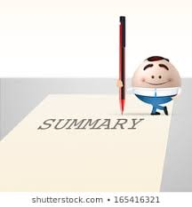
SUMMARIES
Officials in the administration often need to explain complicated or technical issues in writing to a Minister or a Senior Official who is not an expert in the subject.
Complex facts and arguments may need to be explained briefly and succinctly in language which the reader will understand.
Like briefing notes, summaries prepared for Ministers must not exceed one or two pages.
This means focusing on key facts and arguments, excluding irrelevant or unimportant details, and presenting these as clearly and concisely as you can.

Slide 12
USE YOUR OWN WORDS, BUT THE IDEAS OF ORIGINAL TEXT SHOULD NOT BE CHANGED
When writing a summary:
remember that it should be in the form of a paragraph.
A summary begins with an introductory sentence that states the text's title, author and main point of the text as you see it.
A summary is written in your own words.
A summary contains only the ideas of the original text.

Slide 13
The length of the summary varies with the length of the document being summarised but there is no hard and fast rule.
For instance, a short report of two to three pages should need only a short summary paragraph of two or three sentences while a longer report or document may require a summary of two to three pages.
If you are writing a report, you will need to write a summary to go at the head of the report.
a SUMMARY is therefore a statement or account of the main points of an event.

Slide 14
TIPS FOR WRITING A SUMMARY
Read through the document to be summarised from start to finish
Use full, grammatically correct sentences
When you have completed the summary, compare it with the original document
Read the document a second time, underlining the key points
Make a brief note of these key points in your own words
Put the key points in order of importance

Slide 15
EXAMPLE OF CLEAR SUMMARY
Here is a passage of a report written in an official, long-winded style with long complex sentences which obscure the meaning:
We are at the present time, undergoing negotiations with the committee to ameliorate safety practices in the immediate vicinity of the cutting machines commensurate with Health and Safety legislation in an attempt to address the incidences which occurred within this location on a number of occasions during this month when six of our personnel sustained hand injuries and it became necessary to stop production and provide medical assistance. This is in spite of advice from our health and safety officers who assure me that all personnel should be cognisant of the correct procedures. I trust that safer working practices will be established and these incidents will be completely eliminated henceforth.

Slide 16
Here is the same passage rewritten in a much clearer and simpler style:
We are talking to the committee about ways of improving safety near the cutting machines, in line with Health and Safety law. This month, six members of staff injured their hands on these machines. These accidents happened even though our Health and Safety officers assure me that everyone knows how to use these machines. I hope that you will work more safely and carefully from now on.

Slide 17
MINUTES (COMPTE-RENDU in French)
Minutes, also known as minutes of meeting, protocols or, informally, notes, are the instant written record of a meeting or hearing.
Minutus is the Latin word for "small," and it gave rise to both the adjective minute pronounced- my-NUTE, or incredibly small, and the noun minute pronounced MIN-it, or 60 seconds of time.
Though they are pronounced differently, both words refer to small measurements.
In our context, minutes are therefore short instant written records of a meeting.

Slide 18
Types of minutes
There are three standard styles of minutes:
action,
discussion, and
verbatim.
MINUTES
ACTION
DISCUSSION
VERBATIM
Whichever style is used, it is very important that the minutes include a clear record of any conclusions, decisions, recommendations and action points.

Slide 19
Action minutes
This is the most common form of minutes used.
They record the decisions reached and the actions to be taken, though not recording the discussion that went into making the decisions.
They include a report of actions taken since the last meeting as well as planned actions.
It is important to note who is responsible for upcoming actions.
The secretary should save any handouts included with a presentation.

Slide 20
Discussion minutes
They are lengthy and may include information which is not essential to the focus of the meeting.
It may be necessary to keep discussion minutes in a situation where the process behind the decisions may be in question later.
Discussion minutes contain everything action minutes do as well as the discussion which lead to the actions decided upon.
Do not include discussion which does not pertain to the topic at hand.
Be sure to record the speaker and the focus of the presentation as it concerns the topic.

Slide 21
Verbatim minutes
They are like vocal transcripts,
Keep a record of every single word said at a meeting.
They are often long and can be difficult to skim for a particular piece of information.
With the exception of courtroom proceedings and Congress, a verbatim record of a meeting is rarely necessary.
Verbatim minutes will not always follow the agenda.

Slide 22
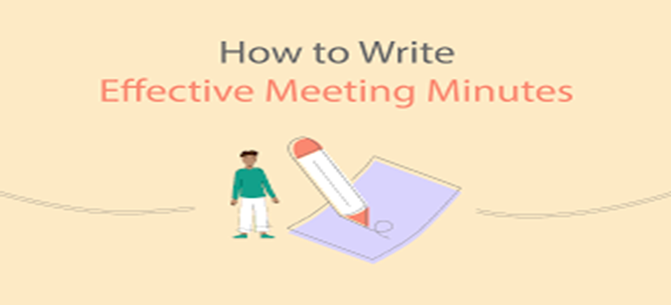
Whether the secretary uses a laptop to record minutes or a microphone and a pen and paper, most minutes follow the agenda of the meeting.
Action minutes are a succinct description of the meeting’s results.
Discussion minutes will flesh out the actions, and
verbatim minutes are a word-for-word record of a meeting.
All three styles of minutes should include any handouts or other reports given to the participants.

Slide 23
KEY POINTS TO NOTE
1- VOCABULARY
Commonly used verbs in minutes are: agree, decide, suggest, recommend, propose, resolve, adjourn, hold, take place, request, act upon, carry out, instigate, initiate, review, consider, bear in mind, take account of, submit, put forward, pursue, follow up, identify.
In general, use the past tense. Use reported speech, the past perfect and the future perfect when necessary.
2- CHRONOLOGY
Follow the order of the agenda (even if the chairperson decides to change the order at the meeting). This makes it easier for a reader (e.g. one who has seen the agenda but was unable to attend the meeting) to follow the minutes.

Slide 24
KEY POINTS- continued
3-PRESENTATION
-Use bold for conclusions, decisions, recommendations and action points.
-Avoid repetition – record each point only once.
-Use plain language – short words and sentences.
4- CONTENT
-Report the attendance and attach the list thereof
-Recall the main items on the agenda
-Record start and end time and signature, rank and designation of secretary

